Slide 1

15.3-2 Area by Double Integration

Slide 2
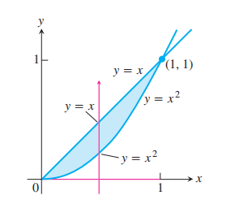

Slide 3
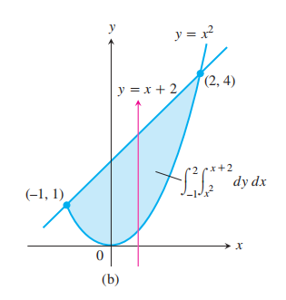

Slide 4


